Slide 1
Open Source for Regulated Manufacturing: GMP‑Compliant IIoT Data Logging
Building scalable, auditable, and compliant IIoT data platforms with ASF technologies

Slide 2
Abstract
Pharma and MedTech production require trustworthy industrial data to meet EU Annex 11 and FDA 21 CFR Part 11 compliance. This talk shows how Apache IoTDB and IIoT architectures can serve as modern historians enabling audit trails, ALCOA+ data integrity, electronic records, and secure time‑series storage. We present a practical blueprint integrating shop‑floor devices with Apache technologies to build scalable, cost‑effective, and compliant data infrastructures. Attendees learn how open source empowers regulated manufacturing to modernize operations, unlock insights, and maintain GMP readiness.

Slide 3
Act 1: The Inciting Incident – The Regulatory Storm of 2026
Storyline of the talk
The Hook: Big Pharma is facing a massive regulatory shift. Annex 11 is ballooning from 1,500 to 10,000 words. Annex 22 is dropping to regulate AI in GMP. Meanwhile, IIoT devices are generating petabytes of high-frequency data.
The Villain: Traditional Historians. They are too expensive to scale, lock you into proprietary vendor ecosystems, and charge extortionate fees per data tag. When you try to scale them to handle IIoT data velocity, they break or bankrupt you.
The Burning Question: Can open-source software actually pass a rigorous FDA/EU GMP inspection? (Spoiler: Yes, and better than proprietary software).

Slide 4
Act 2: The Core Conflict – Mapping ALCOA++ to Data Architecture
Storyline of the talk
The Rules of the Game: Demystify FDA 21 CFR Part 11 and EU Annex 11 in 60 seconds (Record integrity vs. System validation).
The Gold Standard: Introduce ALCOA++ (adding Integrity, Robustness, Transparency, Accountability, and Reliability).
The Gap: Show why standard IT open-source tools fail ALCOA++ out of the box (e.g., mutable databases where logs can be altered or deleted without an audit trail).

Slide 5
Act 3: The Hero Appears – Apache IoTDB & The Compliant Architecture
Storyline of the talk
The Secret Weapon: Introduce Apache IoTDB and the TSFile. Explain why TSFile's immutable design pattern is a regulatory dream (tamper-evident, zero data loss, high compression).
The Global Validation: Mention its UN recognition (Top 60 Global Innovation Case) to build immediate trust and credibility with the enterprise audience.
The Grand Blueprint: Present the end-to-end Apache ecosystem architecture (PLC4X ➔ BifroMQ/Kafka ➔ IoTDB ➔ Iceberg) and show exactly how it creates an unbending chain of custody for data.

Slide 6
Act 4: The Proof – The GAMP 5 Validation Strategy & Takeaways
Storyline of the talk
The Execution: How do you actually validate this open-source stack? Briefly map it to GAMP 5 software categories and IQ/OQ/PQ testing.
The Climax: A quick case example showing the cost and performance comparison between a legacy historian and the Apache stack.

Slide 7
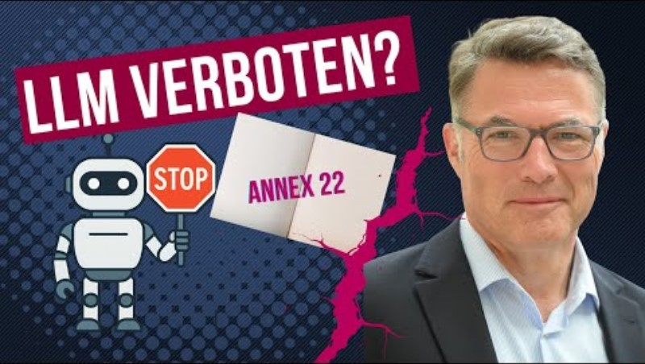

Slide 8
Big Pharma Update: Annex 11 & 22 are Here!
Annex 11 Overhaul: Expanding from 1,500 to 10,000 words, it brings highly detailed requirements for data integrity, cloud computing, and IT security.
The New Annex 22: Created specifically to regulate AI-supported systems within GMP environments.

Slide 9
Introduction
Why data integrity matters in regulated manufacturing (Pharma, MedTech, Food)
Annex 11 & FDA 21 CFR Part 11 in 60 seconds
The challenge: IIoT data volume vs. compliance demands
Motivation: Can open source serve as a compliant historian backbone?
Notes:
Slide Content
GMP‑regulated industries demand trustworthy IIoT data
Annex 11 & FDA 21 CFR Part 11 → focus on data integrity
Open source technologies enable scalable, auditable industrial platforms
Speaker Notes
Open with the core challenge: industrial processes generate massive volumes of time-series data, but regulations require strict control and traceability.
Many vendors offer expensive historians; however, open‑source solutions are now mature enough for regulated environments.
Introduce the goal: show how the Apache ecosystem can power a compliant IIoT platform combining historians, stream processing, ingestion pipelines, and data lakes.

Slide 10
Annex 11 & FDA 21 CFR Part 11 in 60 Seconds
Annex 11 & FDA 21 CFR Part 11 in 60 Seconds 🇺🇸 FDA 21 CFR Part 11 (US Regulation) Defines rules for electronic records & electronic signatures Ensures they are trustworthy, secure, and legally equivalent to paper [certivo.io] Core requirements: Audit trails (time-stamped) User access control System validation Electronic signatures 🇪🇺 EU Annex 11 (GMP Guideline) Governs computerized systems in GMP environments [simplerqms.com] Covers the full system lifecycle: Validation & risk management Data integrity (ALCOA+) Supplier & system governance Periodic review & monitoring [gmpinsiders.com] 🔗 Common Goal Ensure data integrity, traceability, and compliance Enable audit-ready, reliable digital processes instead of paper ⚖️ Key Difference (One-liner) Part 11 = “Are electronic records & signatures trustworthy?” Annex 11 = “Is the entire system validated, controlled, and compliant?” 🎯 Takeaway Both regulations ensure that digital GMP data is trustworthy, auditable, and compliant—across systems, processes, and the full data lifecycle.
🇺🇸 FDA 21 CFR Part 11 (US Regulation)
Defines rules for electronic records & electronic signatures
Ensures they are trustworthy, secure, and legally equivalent to paper

Slide 11
GMP Requirements for IIoT Data
ALCOA+ principles explained
Audit Trail, Electronic Records, Electronic Signatures
Time‑series data challenges in GMP (sampling frequency, compression, lineage)
Why traditional historians struggle or are expensive
Notes:
Slide Content
ALCOA+ principles
Audit trails & electronic records
Validation & reproducibility
High-frequency sensor data introduces challenges
Speaker Notes
Walk through ALCOA+ briefly: Attributable, Legible, Contemporaneous, Original, Accurate + Complete, Consistent, Enduring, Available.
Emphasize how time-series data creates new pressures: rapid ingestion, lossless integrity, versioning, and long-term storage.
Bridge to why specialized time-series systems like IoTDB and TSFile matter.

Slide 12
What is ALCOA++ ?
ALCOA+ is a gold standard framework for ensuring data integrity—the accuracy, consistency, and reliability of data—especially in highly regulated industries like pharmaceuticals, biotechnology, and clinical research.
It builds on the original ALCOA principles (Attributable, Legible, Contemporaneous, Original, Accurate) by adding four more: Complete, Consistent, Enduring, and Available.
Together, these principles provide a comprehensive guide for organizations to maintain trustworthy, auditable, and compliant data throughout its lifecycle.

Slide 13
The 9 ALCOA+ Principles
Principle Definition
Attributable Data must be clearly linked to the person who generated or modified it.
Legible Data must be readable, permanent, and accessible throughout its lifecycle.
Contemporaneous Data must be recorded at the time of the activity, not retrospectively.
Original Data must be the first capture of the information, not a transcription or copy.
Accurate Data must be correct, truthful, and free from errors or tampering.
Complete All data, including deletions or modifications, must be retained and traceable.
Consistent Data must be reliable, reproducible, and aligned with expected patterns or trends.
Enduring Data must be stored on durable media and remain accessible for the required retention period.
Available Data must be readily accessible to authorized personnel when needed.

Slide 14
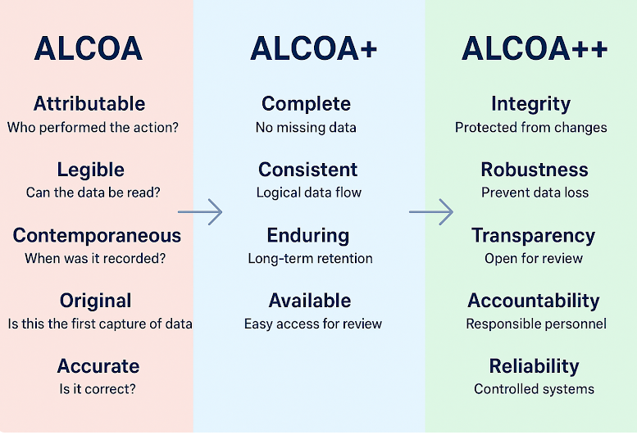
https://www.pharmaguideline.com/2018/12/alcoa-to-alcoa-plus-for-data-integrity.html

Slide 15
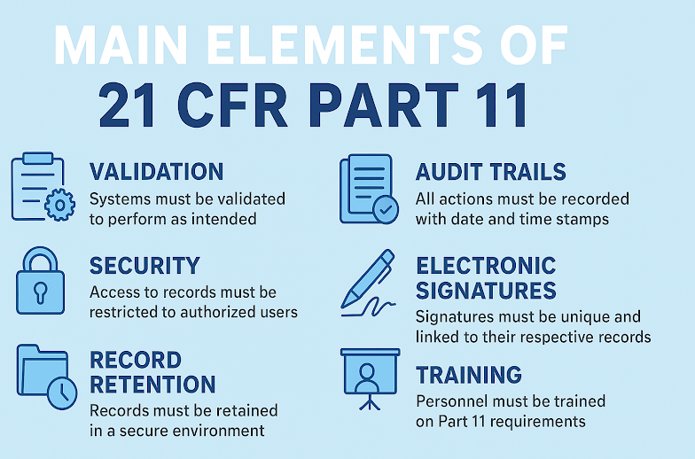
https://www.pharmaguideline.com/2025/11/21-cfr-part-11-requirements-for-laboratories.html#gsc.tab=0

Slide 16
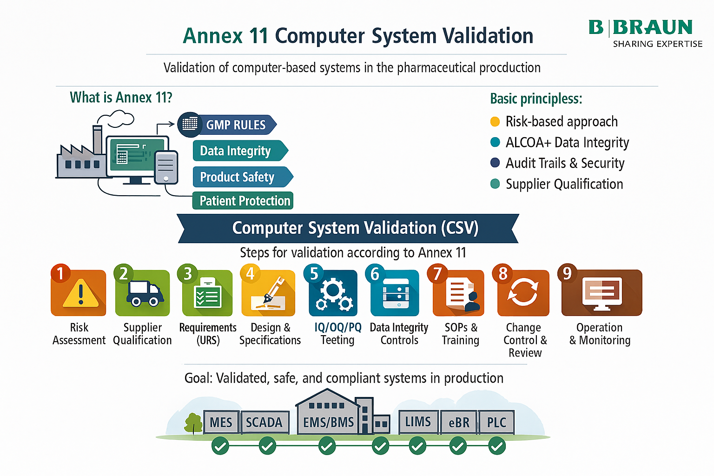
Annex 11 Computer System Validation

Slide 18
Why Traditional Historians Struggle & Are Expensive
Industrial Data Reality
High-frequency sensor & PLC data
Rapid data ingestion & massive volume
Strict ALCOA+ / audit requirements
Traditional Historian Limitations
Scaling constraints → not built for IIoT data velocity
Rigid data model → limited metadata, lineage, reproducibility
Weak audit capabilities → heavy customization for ALCOA+
Siloed architecture → poor integration with streaming & analytics
Commercial Constraints
Proprietary licensing (tags / volume-based)
Vendor lock-in & limited extensibility
Expensive scaling (storage, HA, retention)
High validation & customization effort (GAMP 5 context)

Slide 19
The Role of Open Source in Regulated Environments
Benefits: transparency, extensibility, interoperability, vendor independence
ASF as a trusted ecosystem
Community governance = reduced vendor lock‑in risk
Notes:
Slide Content
Transparency & trust
Extensibility & interoperability
Strong community governance
Vendor independence
Speaker Notes
Explain that open source aligns well with validation because code is inspectable.
Community-driven release cycles reduce lock‑in and increase reliability.
Show that major enterprises rely on Apache foundations for mission‑critical workloads.

Slide 20
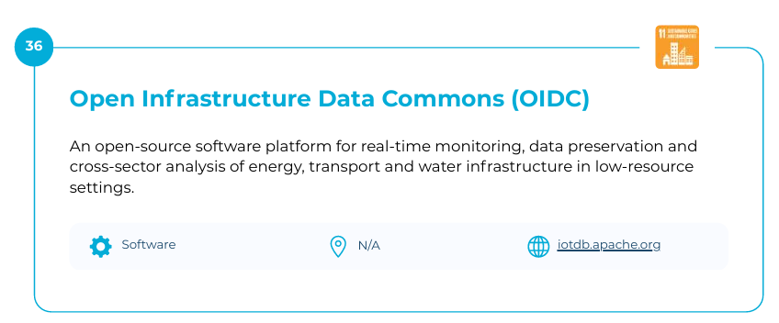
Open Infrastructure Data Commons (OIDC)
An open-source software platform for real-time monitoring, data preservation and cross-sector analysis of energy, transport and water infrastructure in low-resource settings.
2026 STI Solutions Book (5)-compressed.pdf

Slide 21
Apache IoTDB as a GMP‑Compliant IIoT Historian
What IoTDB is (purpose, architecture, performance)
Data model for industrial sensor & PLC data
Audit trail capabilities and versioning
Authentication, authorization, encryption, retention management
Industrial communication integration (MQTT, OPC-UA via connectors)
Notes:
Slide Content
High‑performance time-series ingestion
Schema model for machine data
Role as hot storage
Built-in mechanisms supporting auditability
Speaker Notes
Describe IoTDB's performance advantages in IIoT environments (compression, efficient writes).
Explain why historians are foundational in GMP: all raw sensor data must be captured in its original form.
Mention access control, retention, and logging as components supporting compliance (not turn‑key validation, but enablers).

Slide 22
Apache IoTDB Selected as One of the Top 60 Global Innovation Cases by the United Nations STI Forum
https://www.linkedin.com/pulse/apache-iotdb-selected-one-top-60-global-innovation-cases-o3cdc/?trackingId=FyCa%2FjGICjK2eKBbL7ZHgQ%3D%3D
https://sdgs.un.org/tfm/STIForum2026/Solutionsbook

Slide 23
Core Enabler: Apache TSFile
What is TSFile?
TSFile for Compliance
Immutable design patterns for auditability / Data segmentation enabling efficient validation & review
TSFile + Apache Iceberg
Hybrid Architecture: IoTDB → TSFile → Iceberg Catalog → Data Lake Analytics
Advantages for GMP: reproducible queries, tamper‑evident storage, lineage
Notes:
Slide Content
TSFile overview
TSFile’s immutability & chunked layout
Iceberg for long-term storage
Combined architecture
Speaker Notes
TSFile is highly optimized for large-scale time-series data, offering structured segments ideal for auditability.
Iceberg provides the metadata layer needed for cold storage: schema evolution, ACID, time-travel.
Highlight that GMP audits often require reconstructing historical states — Iceberg makes this reproducible.

Slide 24
Apache Projects for an End‑to‑End IIoT Pipeline
Messaging & Ingestion
Apache Kafka
Apache BifroMQ
Stream Processing & Validation
Apache Flink
Apache Beam
Data Integration & Edge
Apache NiFi
Apache PLC4X
Data Analytics
Apache StreamPipes
Apache Superset
Notes:
6.1 Messaging & Ingestion
Slide Content
Apache BifroMQ (MQTT broker)
Apache Kafka (stream ingestion)
Speaker Notes
Show how BifroMQ allows secure device-to-cloud messaging.
Kafka ensures replayability — an essential property for audit investigations.
6.2 Industrial Connectivity
Slide Content
Apache PLC4X (OPC-UA, Modbus, S7…)
Speaker Notes
Stress how PLC4X provides a unified way to pull machine data using industrial protocols common in manufacturing.
6.3 Integration & Flow Management
Slide Content
Apache NiFi / MiNiFi
Provenance tracking
Speaker Notes
Explain NiFi’s strength: data flow visibility is essential for Annex 11 compliance.
Provenance capabilities allow a “chain of custody” for data transformations.
6.4 Real-Time Processing & Analytics
Slide Content
Apache StreamPipes (low-code industrial analytics)
Apache Flink (stateful stream processing)
Apache Beam (unified batch/stream pipelines)
Speaker Notes
StreamPipes: highlight how domain experts (not just developers) can compose analytics pipelines, dashboards, anomaly detection, and event processing.
StreamPipes is particularly relevant for shop-floor teams that need live monitoring without coding.
Flink provides advanced real‑time validation: threshold detection, patterns, event correlation.
Beam ensures transformation logic can be validated and executed consistently.
6.5 Storage & Analytics
Slide Content
IoTDB (hot storage)
TSFile (intermediate)
Iceberg (cold long-term archive)
Hadoop/Ozone (storage backend)
Speaker Notes
Reiterate the multi‑tier architecture: fast historian, optimized file format, compliant data lake.
Each layer supports different regulatory and operational needs.

Slide 25
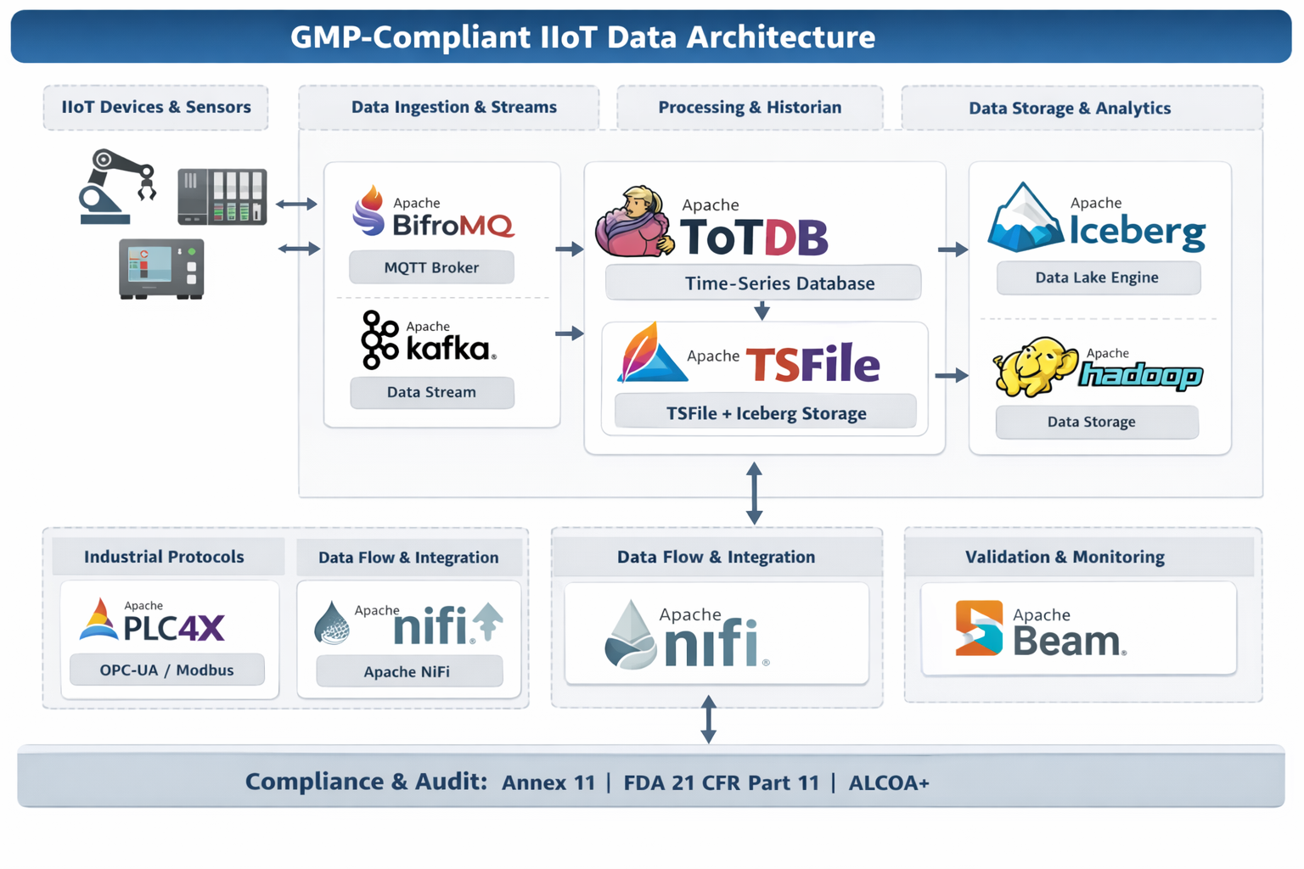
Reference Architecture
A full IIoT + GMP reference architecture combining Apache projects:
Sensors / PLCs / Edge
→ BifroMQ (MQTT) / PLC4X→ Kafka → Flink/Beam processing→ IoTDB (hot historian, TSFile)→ Iceberg (cold compliant archive)→ Superset / BI tools
Include data governance, audit trail storage, retention policies.
Notes:
Slide Content
Diagram: Sensors → PLC4X → BifroMQ/Kafka → NiFi → StreamPipes → IoTDB → TSFile → Iceberg → Analytics
Speaker Notes
Walk step by step through the entire data journey.
Emphasize where audit trails and validation checkpoints occur.
Show how StreamPipes fits between ingestion and historian to enable operational insights.

Slide 26
Compliance Considerations
Annex 11 chapter mapping to open-source capabilities
21 CFR Part 11 mapping (audit trails, user controls, signature concepts)
Validation strategy (GAMP 5, system boundaries, IQ/OQ/PQ)
Notes:
Slide Content
Annex 11: relevant chapters
FDA 21 CFR Part 11: electronic records
Validation strategy: GAMP 5
Speaker Notes
Clarify that open source doesn't remove responsibility for validation — but can simplify and improve transparency.
Map audit trails, access control, data integrity, and reproducibility to the architecture components.

Slide 27
Case Example
Notes:
Slide ContentExample manufacturing lineReal-time ingestion → StreamPipes analyticsIoTDB historian → Iceberg archiveTime-travel investigationSpeaker NotesUse a simple example: sudden temperature spike detected on a filling line.StreamPipes detects anomaly → IoTDB logs raw data → Iceberg supports retrospective investigation.Show how regulators expect you to answer: “What happened, when, and how do you know this data is trustworthy?”

Slide 28
Key Takeaways
Apache ecosystem can support compliant Industrial Data Platforms
TSFile + Iceberg = powerful future for audit‑ready data lakes
Open source enables scalable, transparent, vendor‑neutral GMP architectures
Notes:
Slide Content
Open source is mature enough for GMP IIoT
TSFile + Iceberg = future-proof compliant storage
StreamPipes enables domain experts
Apache ecosystem reduces vendor lock‑in and cost
Speaker Notes
Reinforce the message that the ecosystem is modular, scalable, and validation-friendly.
Encourage adopting open standards to avoid dependency on proprietary historians.

Slide 29
Q&A
Notes:
Invite questions about practical implementation, validation, and integration into existing MES/SCADA systems.
-> e.g. Criticial Manufacturing is built on top of Apache Kafka.

Slide 30
Thank you!

